Slide 1



ARCHITECTURE OF ELECTRONIC COMPUTING MACHINE & COMPUTING SYSTEMS
Prepared & Presented by: Mirlan Nurbekov, Lecturer
Office hours: Friday 9:00–17:00
AlaToo IT & Business College
Fall 2025

Slide 2
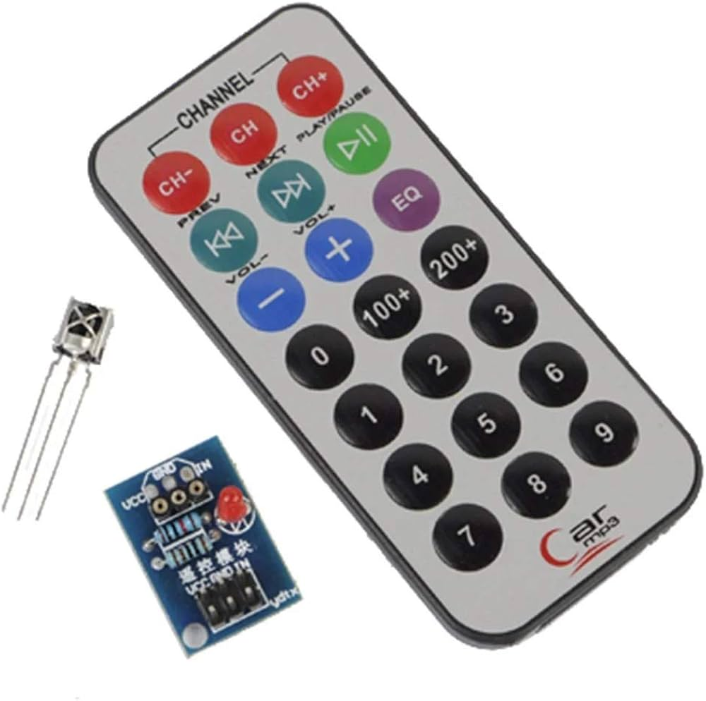
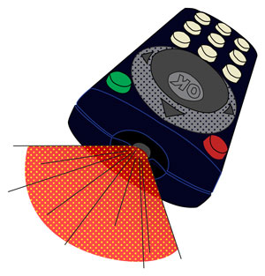
IR remote control & IR sensors

Slide 3
What is infrared light (IR)?
IR = light that is invisible to human eyes
Wavelength range: 700 nm – 1 mm
Common uses: TVs, AC units, cameras, sensors
Works through line-of-sight

Slide 4

IR in everyday devices

Slide 5
How an IR remote works?
Remote has an IR LED
Button press –>LED sends pulse sequence
Pulses represent digital data
Receiver converts pulses into a command

Slide 6
Characteristics of IR communication
Short range (5–10 m)
Line-of-sight required
One-way communication
Inexpensive and reliable

Slide 7
IR communication protocols
NEC (Nippon Electric Company)
Sony
RC5 / RC6
Custom protocols used in appliances

Slide 8
The NEC protocol
32-bit data structure
Contains address + command
Uses pulse distance encoding
Has a repeat code when button is held

Slide 9
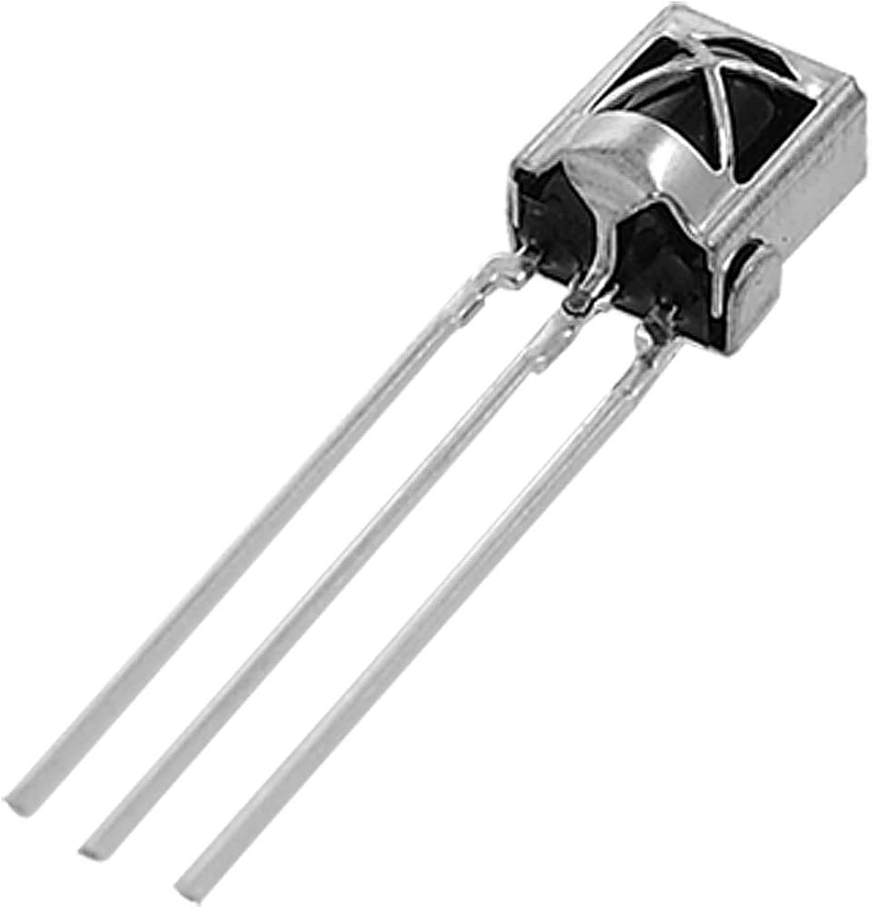
The VS1838B IR receiver
3 pins: output, ground, VCC
Works at 38 kHz
Filters noise and modulated signals

Slide 10
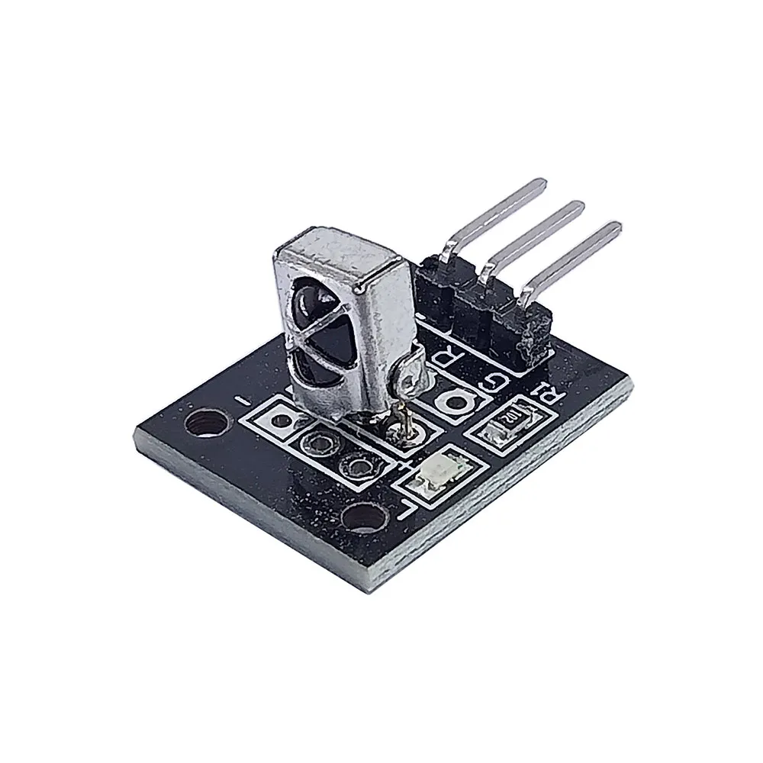
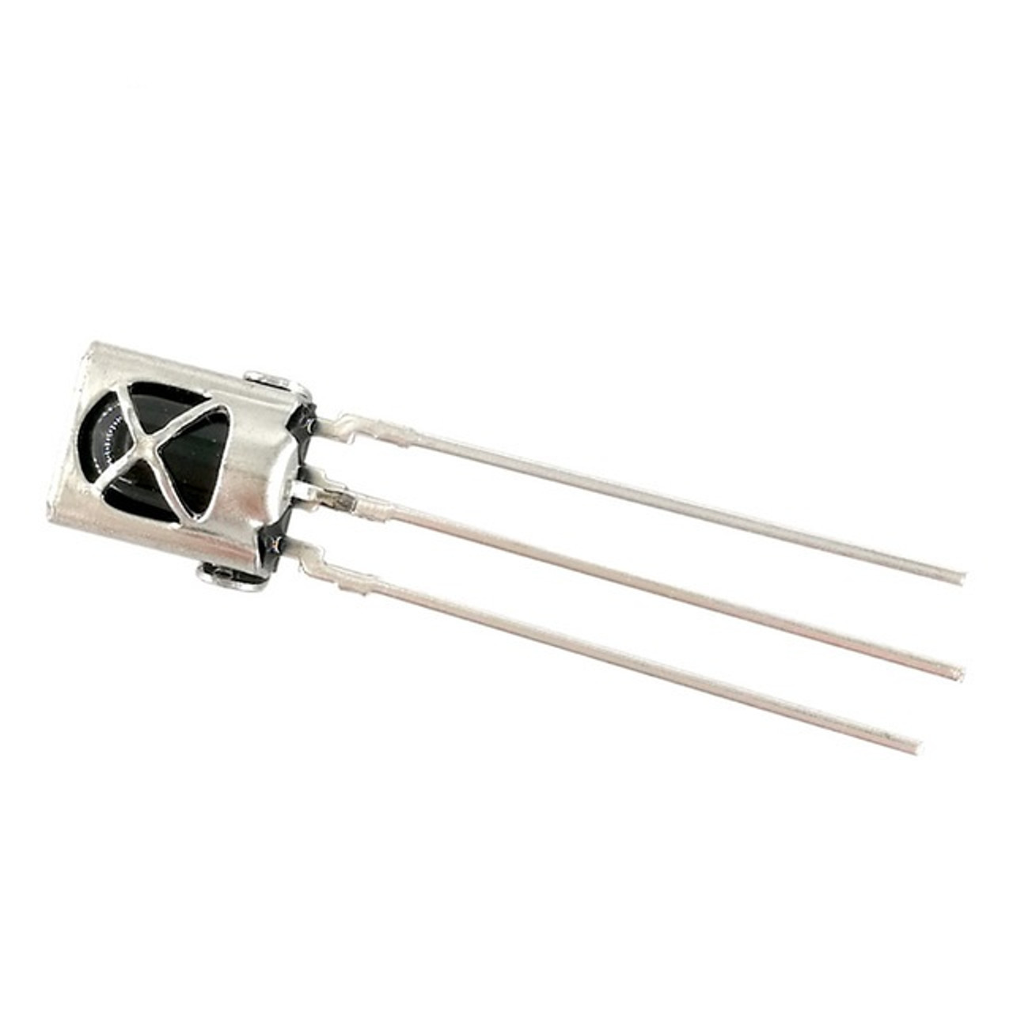
The VS1838B IR receiver

Slide 11
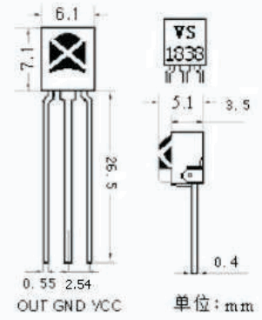
The VS1838B IR receiver

Slide 12
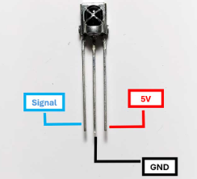
The VS1838B IR receiver

Slide 13
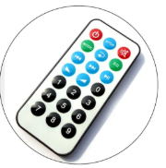
Remote controlling unit

Slide 14
Installing the IRremote library
1. Open Arduino IDE
2. Sketch → Include library → Manage libraries
3. Search “IRremote”
4. Install by Armin Joachimsmeyer
5. Include: #include <IRremote.hpp>

Slide 15
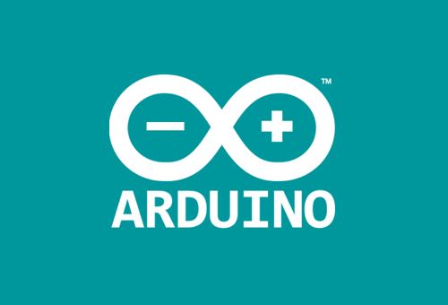
How it works?
Each button sends a unique code
Code has: protocol, address, command
Sensor converts IR light → electrical pulse

Slide 16
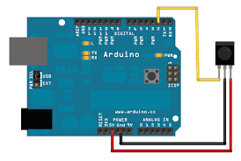
Wiring IR sensor to Arduino
OUT → D2 (recommended)
GND → GND
VCC → 5V

Slide 17
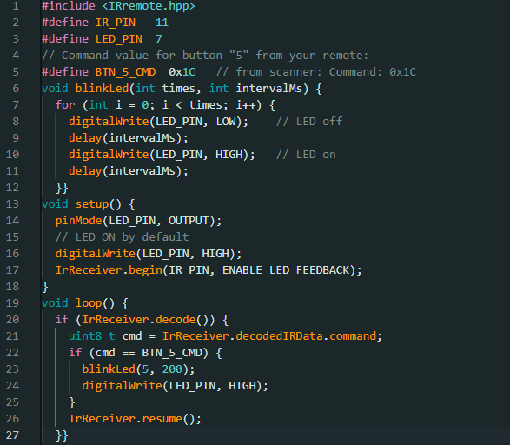
GAME PART 1

Slide 18
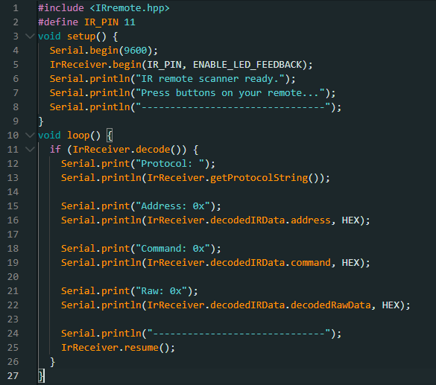
GAME PART 2

Slide 19
What values Arduino reads?
Protocol – encoding type (NEC, Sony, etc.)
Address – device group
Command – actual button number
Repeat = 0x0 when button held

Slide 20
How to test your remote codes?
Open Serial Monitor (9600 baud)
Point remote to sensor
Press each button one time
Write down each command value
Use these values in your project

Slide 21
Full code sample
https://github.com/AlaTooMirlanNurbekov/A003_Architecture_of_Computing_Systems/blob/main/0002_codes/0007.ino

Slide 22
Self test
1. What is infrared (IR) light and why is it invisible to human eyes?
2. What conditions are required for IR communication to work properly?
3. What does an IR remote send when a button is pressed, and how does the receiver interpret it?
4. What makes the VS1838B suitable for Arduino projects? (mention two features)
5. How do you wire the VS1838B sensor to an Arduino UNO?

